Slide 1
Russian Handwritten Lexicons:
Digital Representation

Slide 2
Russian handwritten lexicons: general information
created at the end of the 16th century
more than 150 lexicons
more than 9 types
from 700 up to 16,000 word entries
alphabet arrangement
foreign words of Greek, Latin, Hebrew, Church Slavonic, Ruthenian, Tatar, Arab, Persian, and German origin
important source for historical lexicography

Slide 3
Russian handwritten lexicons: general information
created at the end of the 16th century
more than 150 lexicons
more than 9 types
from 700 up to 16,000 word entries
alphabet arrangement
foreign words of Greek, Latin, Hebrew, Church Slavonic, Ruthenian, Tatar, Arab, Persian, and German origin
important source for historical lexicography

Slide 4
Russian handwritten lexicons: general information
created at the end of the 16th century
more than 150 lexicons
more than 9 types
from 700 up to 16,000 word entries
alphabet arrangement
foreign words of Greek, Latin, Hebrew, Church Slavonic, Ruthenian, Tatar, Arab, Persian, and German origin
important source for historical lexicography

Slide 5
“An Explanation of the words
difficult for understanding in texts,
as these words are translated by the first interpreters some in Church Slavonic, some in Serbian, others in Bulgarian, some in Greek and other languages and which were not translated into Russian”
(Russian National Library in St. Petersburg,
Solovki collection, № 302/322)
was created at the beginning of the 17th century as an addition to the “The Ladder of Divine Ascent” of John Climacus
consists of five smaller lexicons of about 1,000 word entries in total

Slide 6
“An Explanation of the words
difficult for understanding in texts,
as these words are translated by the first interpreters some in Church Slavonic, some in Serbian, others in Bulgarian, some in Greek and other languages and which were not translated into Russian”
(Russian National Library in St. Petersburg,
Solovki collection, № 302/322)
was created at the beginning of the 17th century as an addition to the “The Ladder of Divine Ascent” of John Climacus
consists of five smaller lexicons of about 1,000 word entries in total

Slide 7
“An Explanation of the words
difficult for understanding in texts,
as these words are translated by the first interpreters some in Church Slavonic, some in Serbian, others in Bulgarian, some in Greek and other languages and which were not translated into Russian”
(Russian National Library in St. Petersburg,
Solovki collection, № 302/322)
was created at the beginning of the 17th century as an addition to the “The Ladder of Divine Ascent” of John Climacus
consists of five smaller lexicons of about 1,000 word entries in total

Slide 8
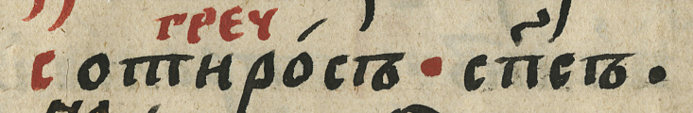
Entry structure
Headword: Greek word σωτήρος in Cyrillic letters
Language mark: initial letters
of the word греческий – the Greek language
Explanatory part:
translation of the Greek word – ‘saviour’

Slide 9
Entry structure
Headword: Greek word σωτήρος in Cyrillic letters
Language mark: initial letters
of the word греческий – the Greek language
Explanatory part:
translation of the Greek word – ‘saviour’

Slide 10
Entry structure
Headword: Greek word σωτήρος in Cyrillic letters
Language mark: initial letters
of the word греческий – the Greek language
Explanatory part:
translation of the Greek word – ‘saviour’

Slide 11
TEI encoding
<entryFree>
<form norm="сотиросъ">Сотиро́съ
<note place="above">
<lang value="grc">
<hi>греч</hi></lang></note>
</form>
<sense>
<def>сп҃съ.<lb/></def>
</sense>
</entryFree>

Slide 12
Digital representation
Text with TEI mark up
+ search options
normalized headword
foreign etymon
source language
source text
topic group

Slide 13
Digital representation
Text with TEI mark up
+ search options
normalized headword
foreign etymon
source language
source text
topic group

Slide 14
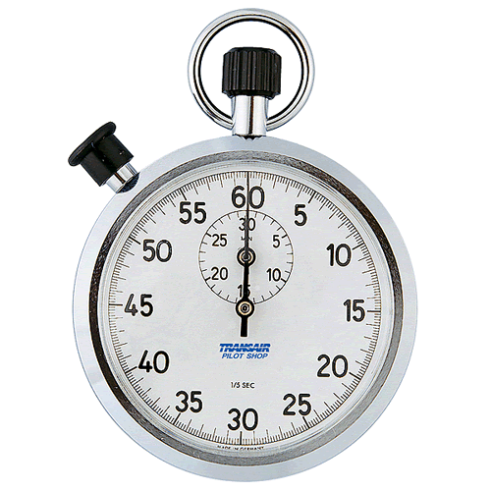
Time’s Up!
Thank you
for your attention!
Kira Kovalenko
Institute for Linguistic Studies,
Russian Academy of Sciences
kira.kovalenko@gmail.com

